Slide 1
Microservices and DevOps
Scalable Microservices
MicroService exercises
Henrik Bærbak Christensen

Slide 2
Exercise 1
Using the Fowler/Newman definitions of microservices, analyze SkyCave’s architecture and…
Argue that SkyCave is a MS architecture
Based upon the aspects it has, that are MS style
Argue that SkyCave is not a MS architecture
Based upon the aspects, that collide with the MS style

Slide 3
Exercise 1
Pro? Con?

Slide 4
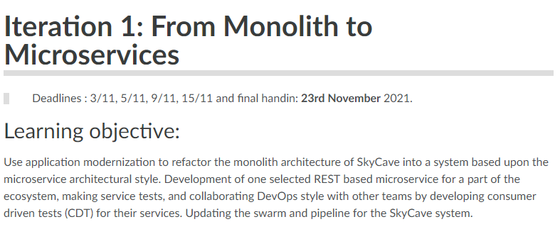
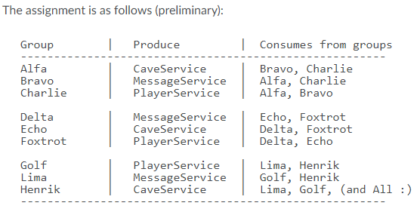
Exercise 2
Start on the First Mandatory Exercise’ Strangling aspect
Who are the groups?

Slide 5
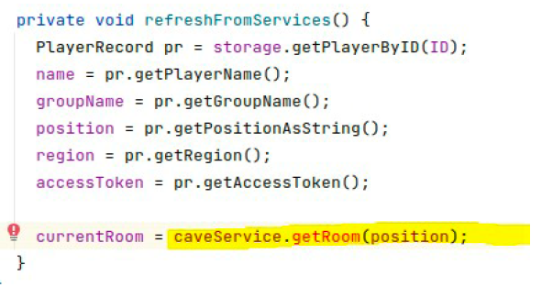
Exercise 2
As argued, you can start strangling right away!
Example:
My group must develop ‘CaveService’
Obvious “small step” is to strangle all Player calls to CaveStorage that do “cave service responsibilities’ into calling a FakeCaveService
I.e.
storage.getRoom(p)
→
caveService.issueGETrequest(p)

Slide 6
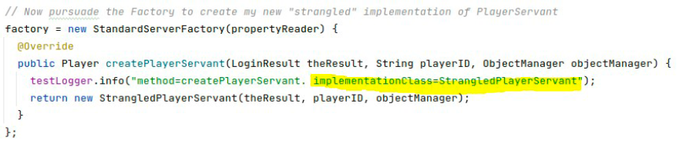
Exercise 2
I advice to
Branch your repo to a ‘strangling branch’
Support ‘do over’ – all is shit code!!!
Maintain old PlayerServant in parallel; by…
… using the factory system to create the new implementation:

Slide 7
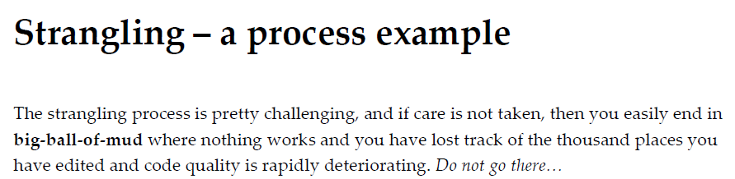
Exercise 2
Have a look at my guide, if it seems a bit scary…
However, just ‘hardwire the FakeCaveService()’ instead of using the CFP system, it is a smaller step…
Fake it till you make it…

Slide 8
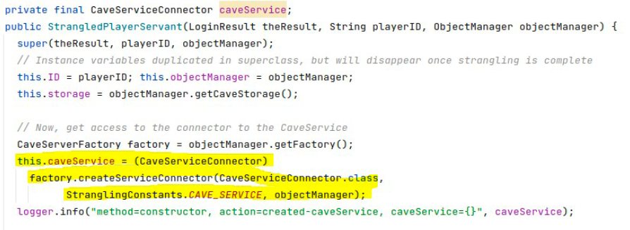
Exercise 2
Fake it till you make it…
this.caveService = new FakeCaveService();

Slide 9
Exercise 3
Create one or more QAS for SkyCave that express reasonable architectural requirements for
Availability QA
Modifiability QA
Performance QA
Testability QA
Next, evaluate if SkyCave meets these requirements

